Slide 1

Data Analysis of Per Capita: National GDP Growth vs. Higher Education Levels
Kenneth ACEY, Paul Eppers,
John Klinges, Nadia lashaw
The Data Analytics Boot Camp at UNC-Chapel Hill

Slide 2
Why was this topic chosen?
Why did we pick this topic?
Our Proposal
Our Hypothesis
Our Hypothesis
Group thought it would be interesting to determine factors driving GDP growth besides more obvious ones such as population growth.
Analyze which countries in the world lead in both per capita GDP and higher ed. levels.
GOAL → Create a visualization of the trend for GDP vs. Higher Ed. levels
(On a per capita basis) there is a link between countries with strong growth in GDP and those with higher levels of education.
Notes:
Touch on what motivated us to pick this topic. Describe the questions you and your group found interesting.

Slide 3
Questions:
What were the leading countries by GDP per capita for the years reviewed (2017 – 201x)?
By year, what are leading countries for higher education on a per capita basis?
Do higher level of per capita education levels drive current (or future levels) of national GDP growth?
How does the US compare to the global measures of GDP versus education?
Notes:
Describe whether you were able to answer these questions to your satisfaction.

Slide 4
Data Exploration & Clean-up Process
We explored using API’s to obtain the GDP data but used
World bank open data source, obtaining the datasets via
Kaggle.com(https://www.kaggle.com/theworldbank/world-bank-gdp-
ranking?cselect=gdp-ppp-csv-.csv)
2. Data saved in cleaned in XXXX API →
____Py
3. World Bank Data Cite:
extract CSV files.
The data was split by year starting
from 201x-2017.
Separate Jupyter notebooks.
5. Created dataframes:
Appended the API with the csv file
b. Create columns for the Leading Countries per GDP vs. Levels of Education per GDP.
6. Created a visualization of GDP countries onn a per capital basis.
a. Multiple drivers of GDP were found.
7. Frequency distribution bar charts were created.
a. This helped visualize high higher education leve;s were associated with listed drivers of GDP.
8. Created a dataframe with the main genres.
a. Used a stacked bar graph to show the main trends within overall country GDP growth. b. Saved all of the charts into PNG files.
Notes:
Run through a jupyter notebook
Discuss insights you had while exploring the data that you didn't anticipate
Multiple subgenres were used to describe each song.
Discuss any problems that arose after exploring the data, and how you resolved them
The spotpy api was a bit cumbersome
Present and discuss interesting figures developed during exploration, ideally with the help of Jupyter Notebook

Slide 5
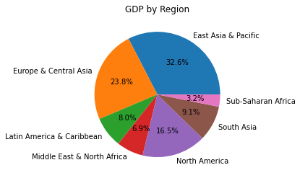
Global GDP Growth - 2017

Slide 6
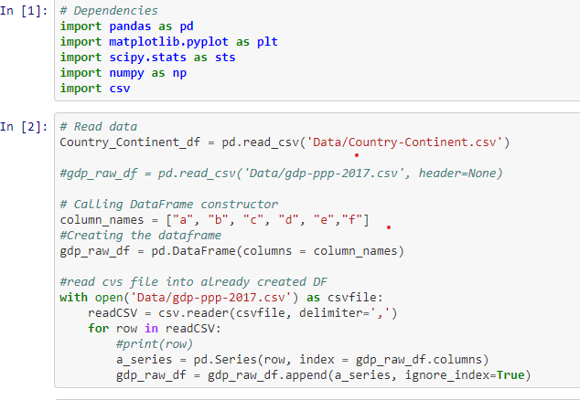
Description of analysis process (in our Jupyter Notebook) The Basics:

Slide 7
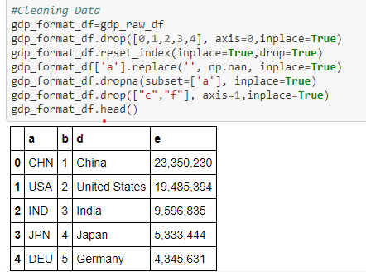
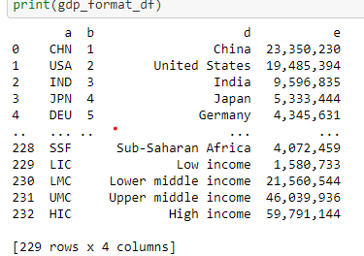
Describe of the data exploration and cleanup process

Slide 8
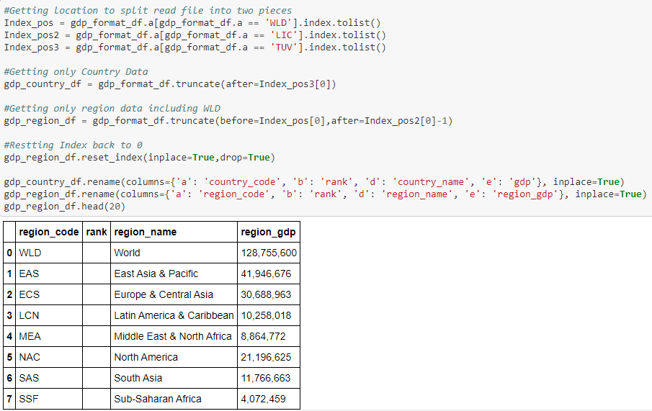
More cleaning of the data

Slide 9
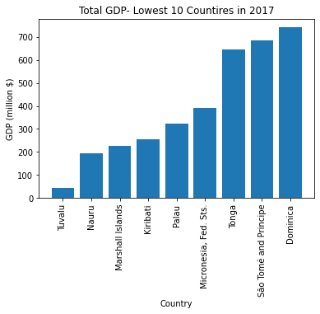
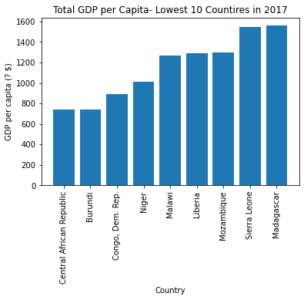
Lowest Countries by GDP– 2017

Slide 10
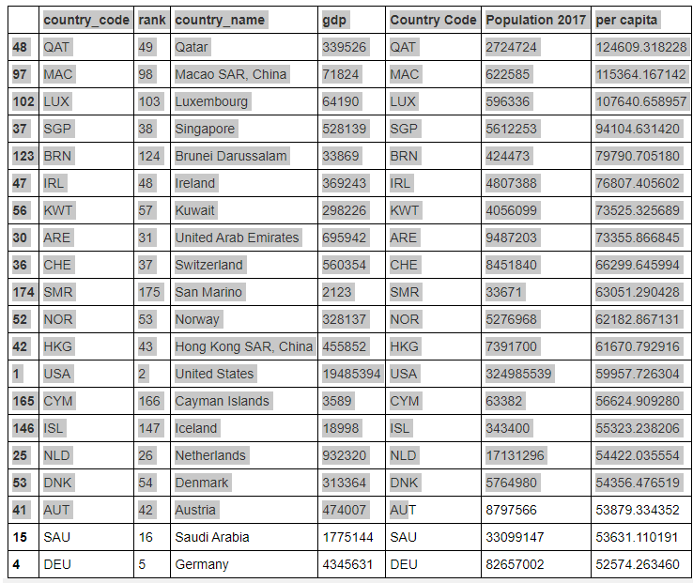
TRENDS 201X

Slide 11
TRENDS 201X

Slide 12
TRENDS 201X

Slide 13
TRENDS 201X

Slide 14
Some challenges we faced:
Obtaining a good data site or API.
Finding a pertinent variable to run against GDP
Analyzing linkage between GDP and education levels.
Years of Music:
World Bank website was very well organized for:
Sorting by country
and GDP and 2. saving data pulls
into a csv file.
Did we have enough data to conclude that education levels could be factor in/driver of national GDP growth?
Need to measure and analyze outliers (where high national GDP and educational levels did not exist simultaneously
Considered measuring GDP growth against growth in: population, immigration, birth rates, and educational levels.
Divided the national GDP figure by population to get GDP per capita.
Need to discuss should we adjust GDP / per capita by the PPP (adjusting the GDP figure by the nation’s cost of living).
Process Challenges:
We xxxxxxx.
We xxxxxxx.;
Notes:
What would we do if we had 2 more weeks:
Global trends
Go further back by year.

Slide 15
Our Findings/Discussion
Through the exploration of this data we expect to obtain the ability to
conclusively say one global region’s GDP is higher than the next. This analysis will
be both through numerical data, and graph production.Txxxxxxxxxxxxxxxxxxxxxxx.
xxxxxxxxxxxxxxxxxxxxxxxxxxxxxxxxx
xxxxxxxxxxxxxxxxxxxxxxxxxxxxxxxxxxxxxxxxxxx.

